Slide 1
Simulation Study of a STATCOM for Reactive Power and Harmonics Compensation

Slide 2
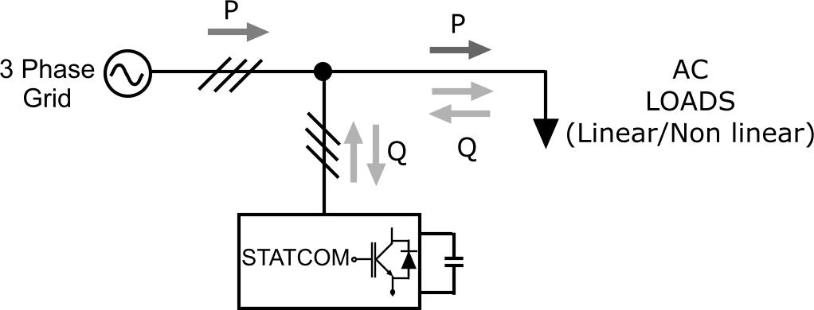
What is the function of STATCOM?
The STATCOM functions by injecting or absorbing reactive power into or from the power grid, dynamically adjusting its output as system conditions change.

Slide 3


What is the process of the whole project?
Three phase inverter
$$↓$$
STATCOM with linear load
$$↓$$
STATCOM with non-linear load
Stretch goal:

Slide 4
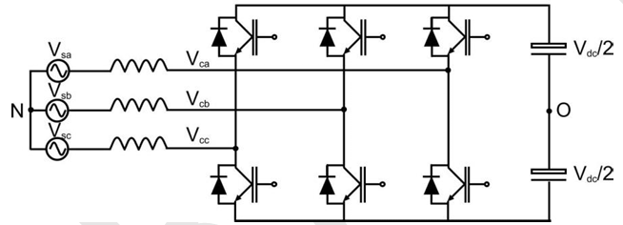
Three-phase inverter
Function:
A three-phase inverter is primarily used to convert direct current (DC) into alternating current (AC) across three phases.
Two-level converter:
Power Switches: The converter uses six power semiconductor switches (IGBT in this project). Each phase of the output uses two switches that connect to the positive and negative of the DC supply.
Operation: By rapidly switching the power semiconductors on and off in a controlled sequence, the inverter creates a staircase waveform that approximates a sinusoidal AC waveform across its output.

Slide 5
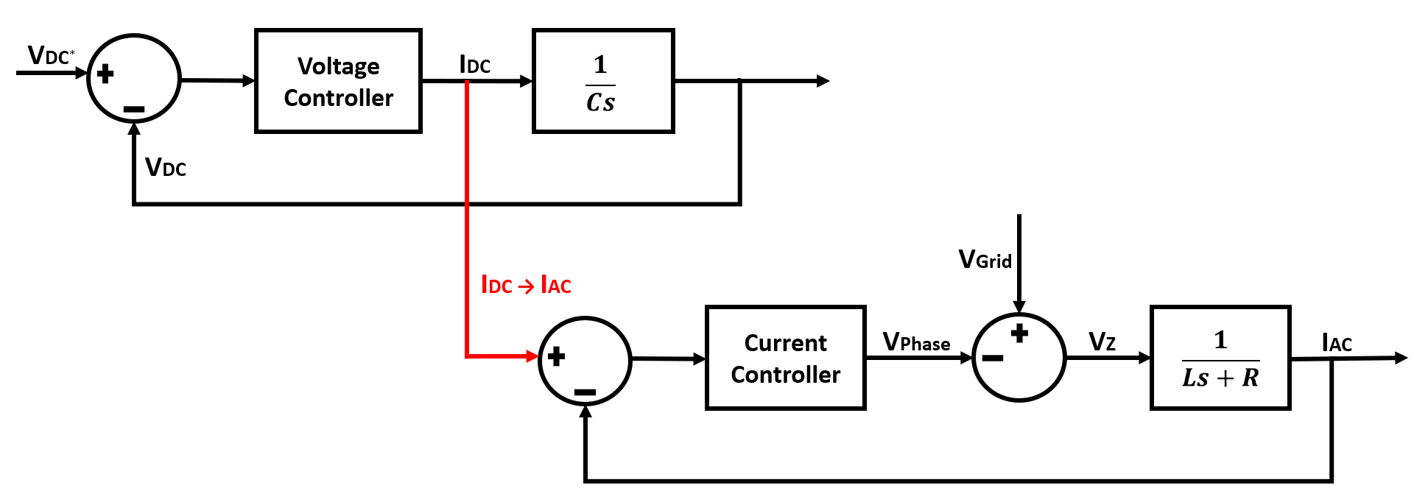
Three-phase inverter
Voltage controller and current controller:
Laplace transform
Block diagram
Deriving transfer function

Slide 6
Three-phase inverter
Verification:
Transfer function verification in MATLAB
Current controller verification
Voltage controller verification
Ripple verification
Deliverables
Current controller
Voltage controller
The three phase inverter

Slide 7
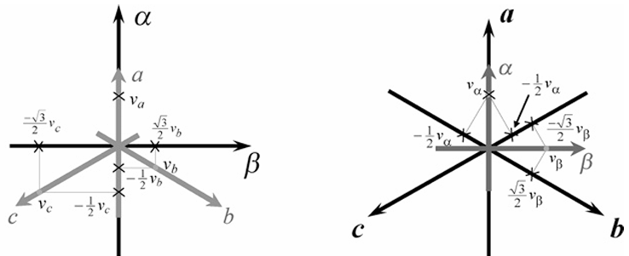
STATCOM with linear load
Reactive power compensation algorithms:
P-Q theory
Clark transform

Slide 8
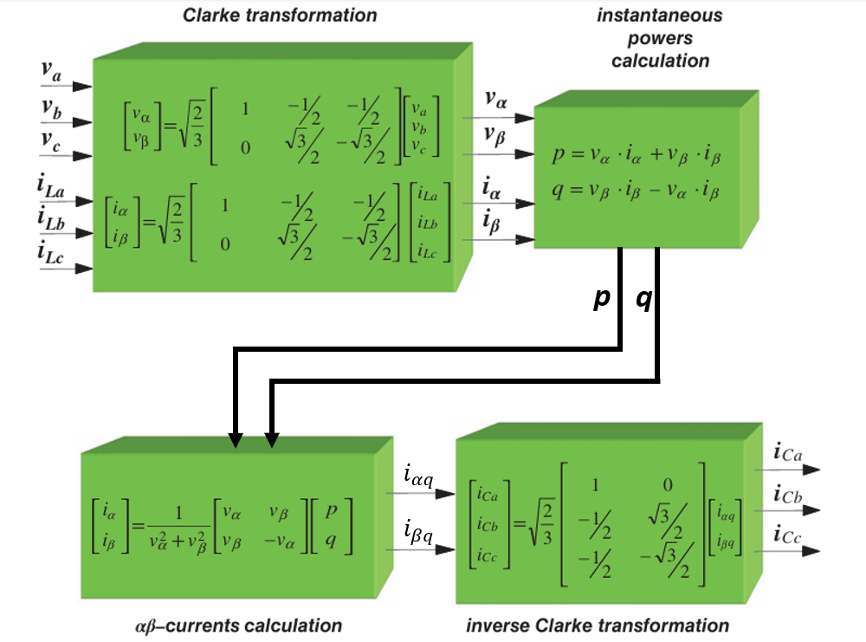
STATCOM with linear load

Slide 9
STATCOM with linear load
Verification:
Reactive power compensation verification
Current controller verification
Voltage controller verification
Deliverables:
Model the STATCOM as an ideal voltage source.
Fully controlled 3 phase STATCOM with linear load

Slide 10
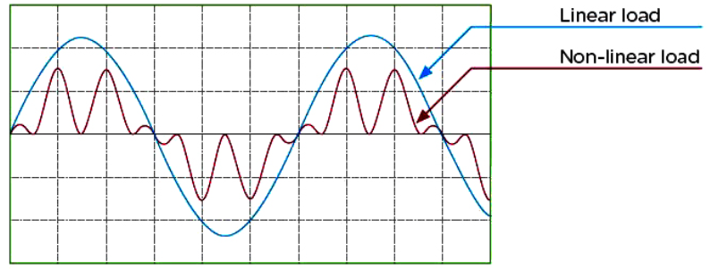
Stretch goal: STATCOM with non-linear load
Characteristics of nonlinear loads：
The voltage is not proportional to the current.
Harmonic currents

Slide 11
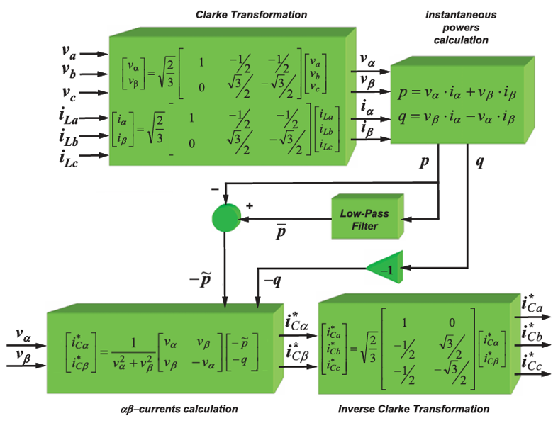
Stretch goal: STATCOM with non-linear load

Slide 12
Stretch goal: STATCOM with non-linear load
Verification:
Filter verification
Reactive power compensation verification
Current controller verification
Voltage controller verification
Harmonics compensation verification
Deliverables
Complete simulation of fully controlled 3 phase STATCOM with non-linear load.

